Slide 1

Work Progress

Slide 2
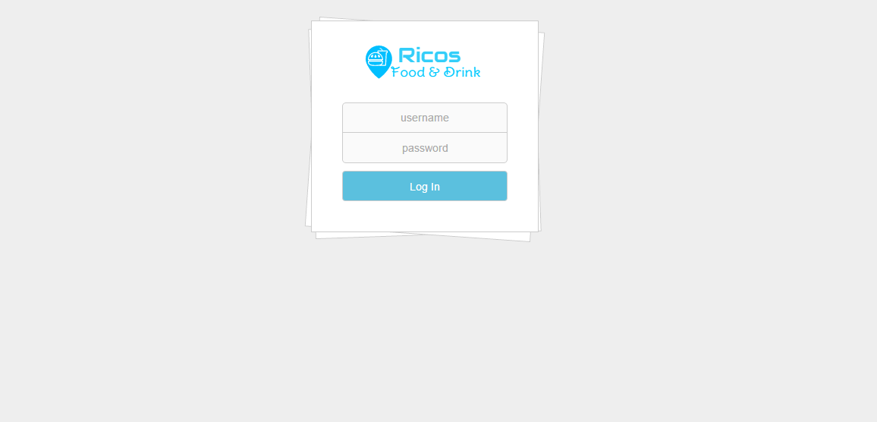
Back-End Ricos

Slide 3
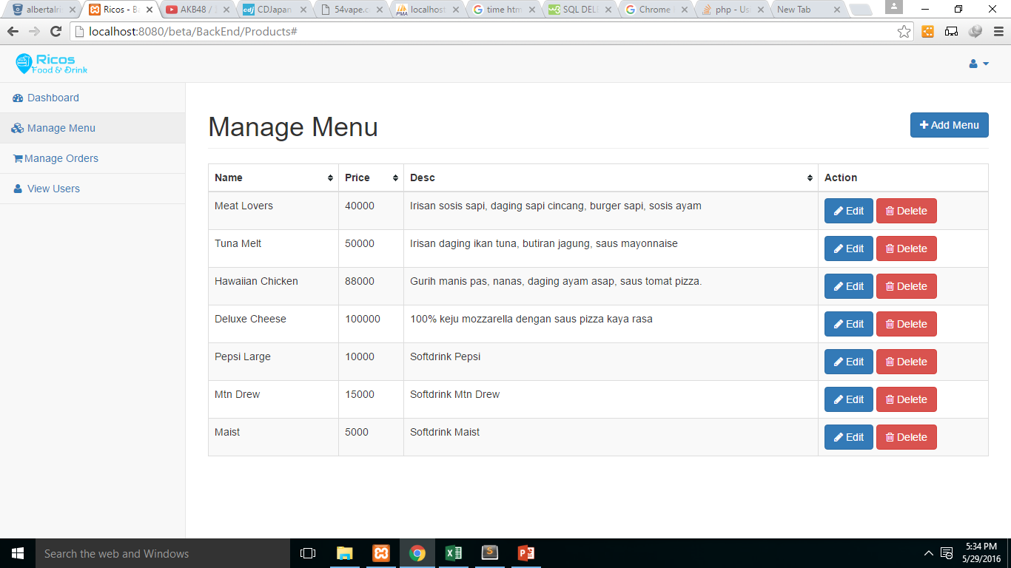
Manage Menu Item (1/3)

Slide 4
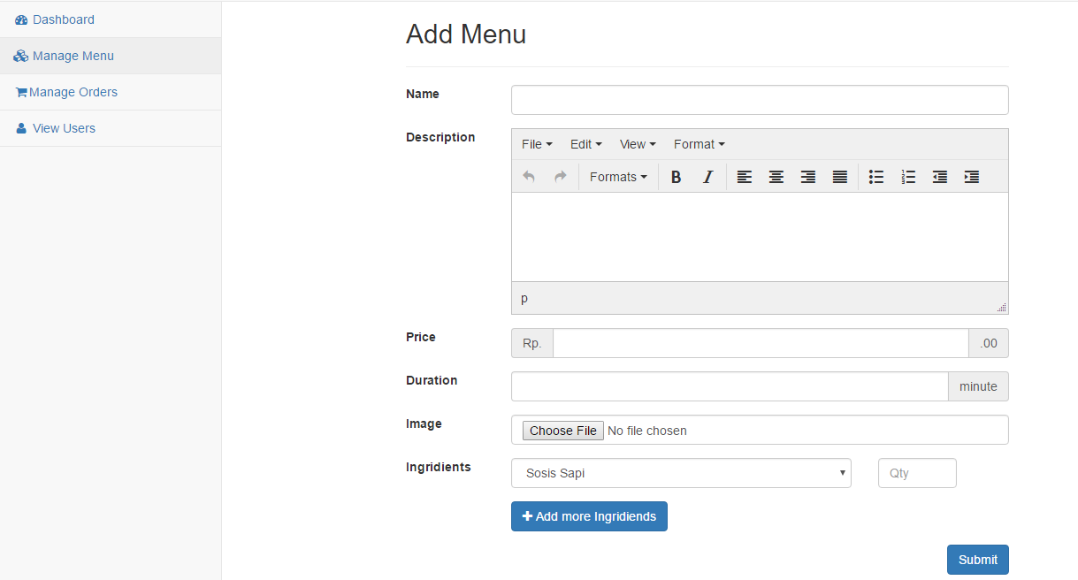
Manage Menu Item (2/3)

Slide 5
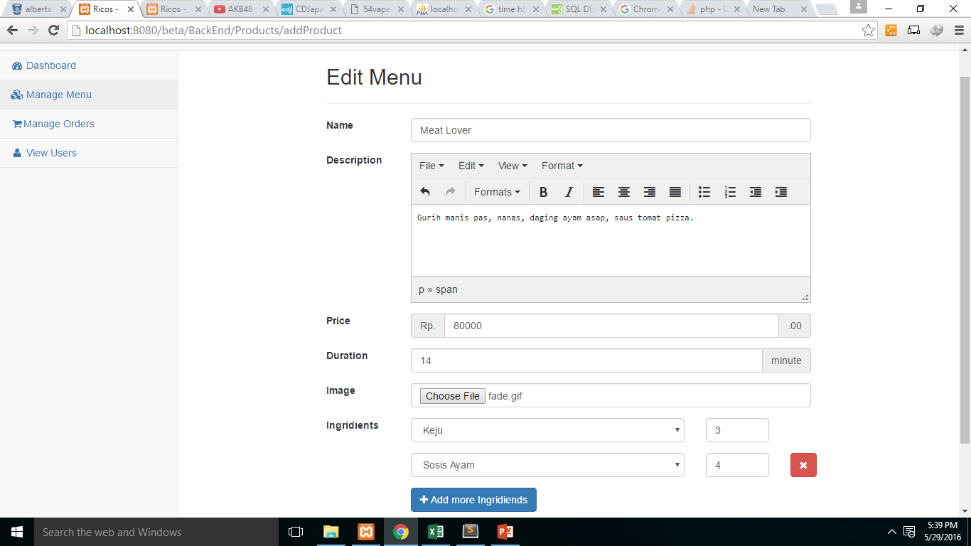
Manage Menu Item (3/3)

Slide 6
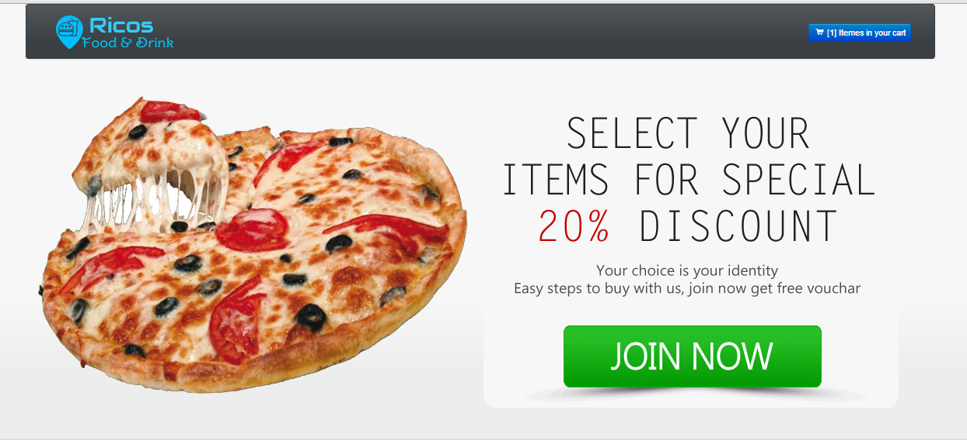
Front-End Ricos

Slide 7
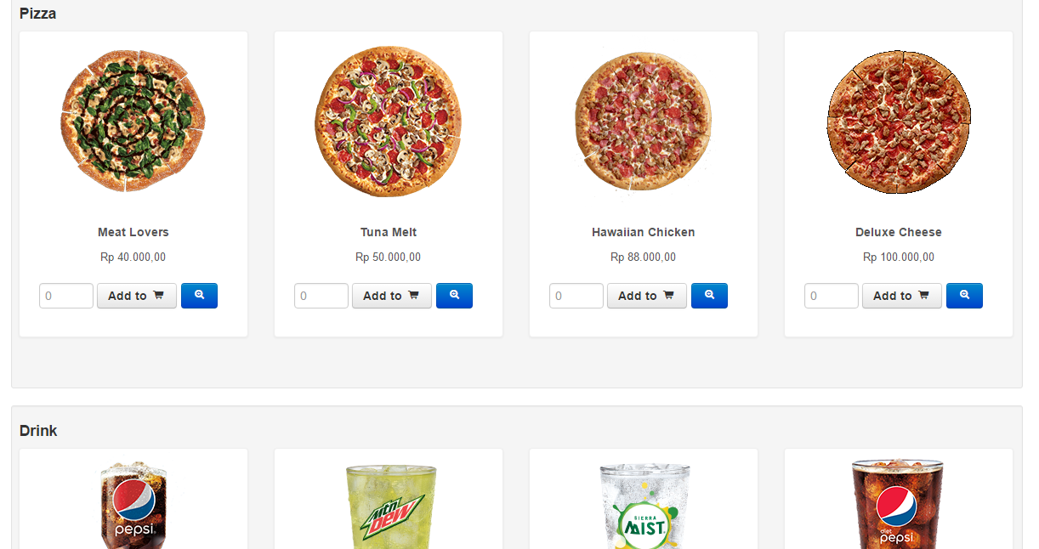
View Menu

Slide 8
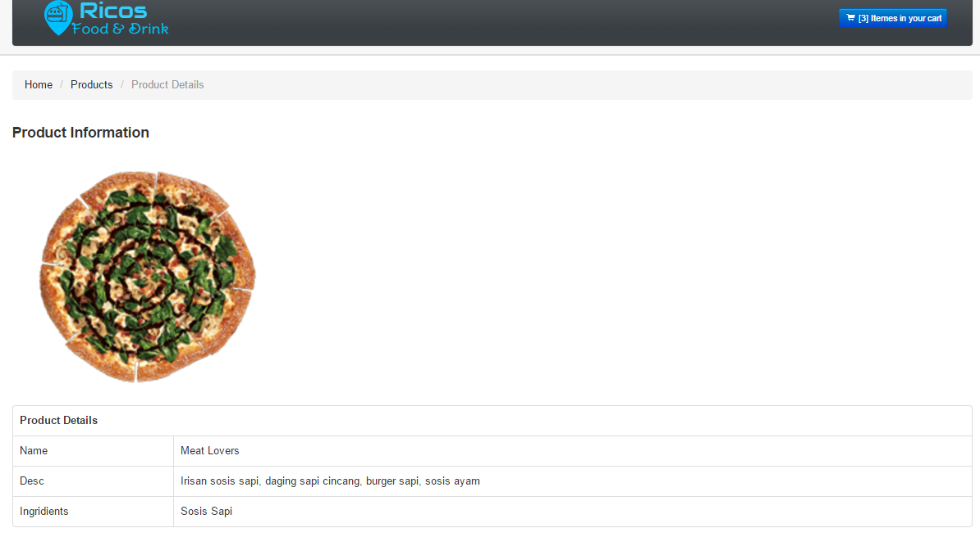
View Ingridients / Detail Menu

Slide 9
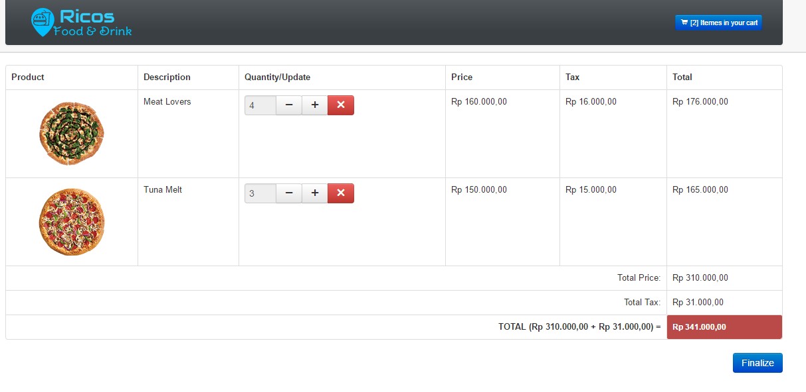
View Cart before Order

Slide 10
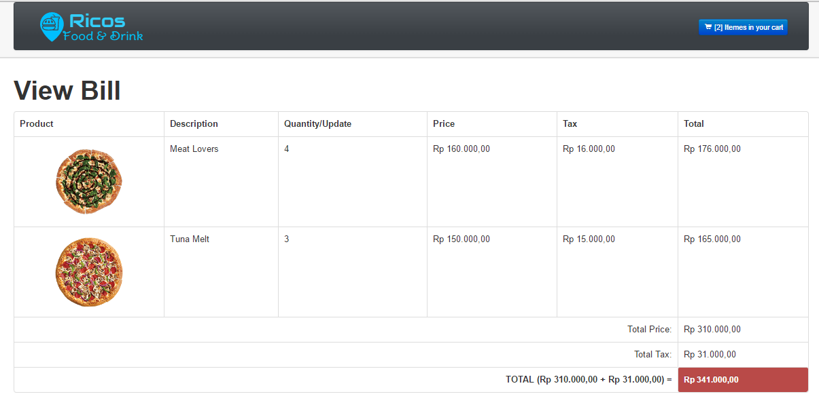
View Bill

